Slide 1
Demographic and Art Style
By Lenneth Dayaon

Slide 2


Our Target Audience
Mobile Casual Gamers
Gender: Female
Age: 21- 35
60 – 70% of the current market
21-35
Notes:
The target audience for our game are mobile casual gamers who are Female and in-between the ages of 21 – 35.
They are the dominant demographic because they take up 60 – 70 % of the current market.

Slide 3
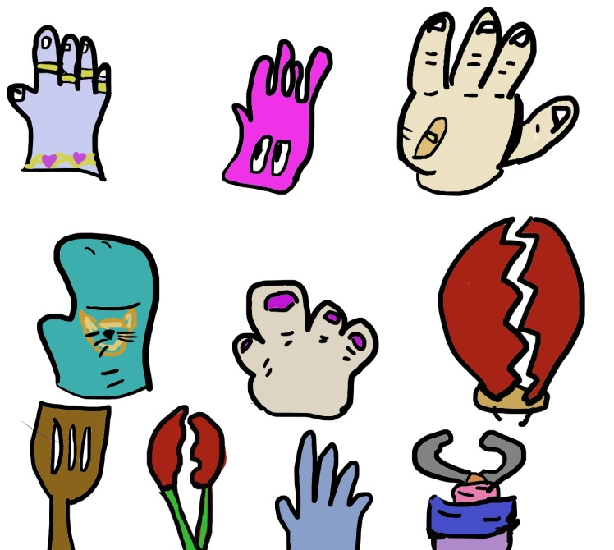
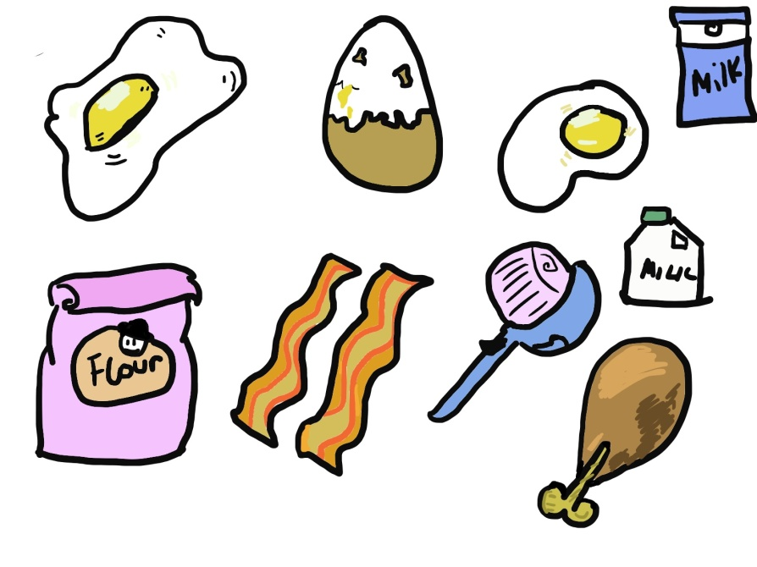
The Art style We Chose
Cell shaded Graphics
Cartoon Style
Why?
Easy to download
Easy to recognize
Casual Games have similar art styles
Immersring the player
Notes:
The art style we chose for our game are cell shaded graphics that are very cartoony.
This is an example of the art style we are going for that we designed as a prototype.
So, why did we choose this art style.
Its on a mobile, these 2d images are easy to download and the game is only small so we don’t want the graphics taking up a lot of storage space as it would be unnecessary.
It makes it easy for the players to recognize what certain items and objects are. It’s a fast paced game so if our items have 3D graphics it can slow down the game and lag or it could confuse the players as it doesn’t flow with the game. Aids recognistion as this art style is in high contrast.
From researching Casual Games, we realized that they all go for similar 2D art styles which appeals to the demographic’s psychographic, allowing it to artistically flow with that target audience.
TINgaming(13 August, 2016) WHO’S THAT POKEMON!? (Gen 1) – Interative Quiz. Available at: https://www.youtube.com/watch?v=gsEaPpnBtPQ (Accessed: 06/02/2018)
PokemonWikia(2018) Ditto. Available at: http://pokemon.wikia.com/wiki/Ditto (Accessed:06/02/2018)

Slide 4
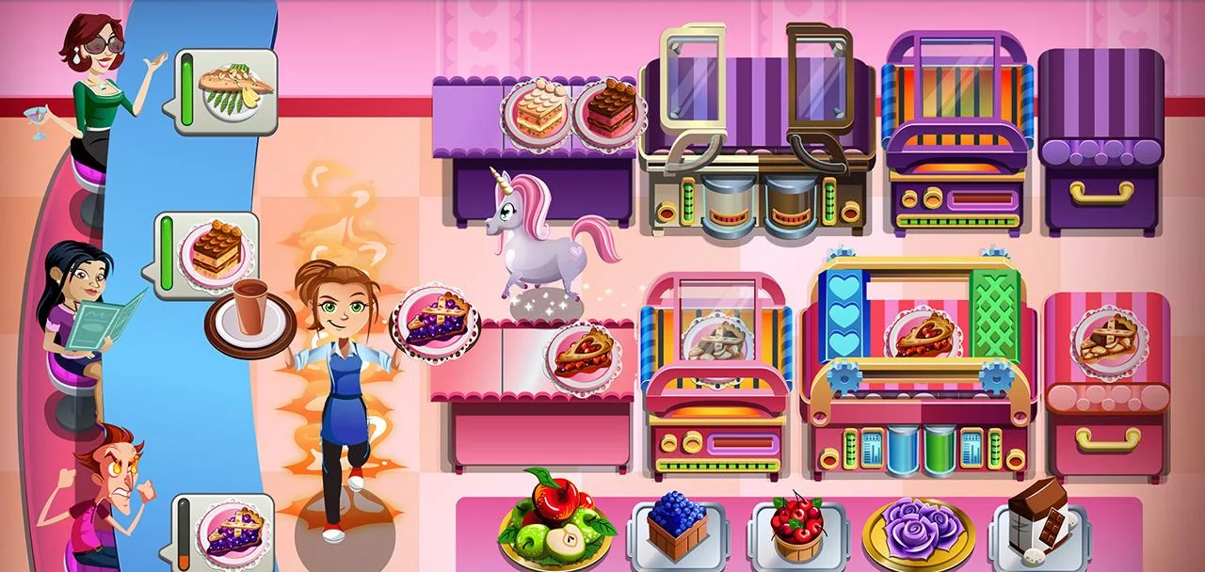
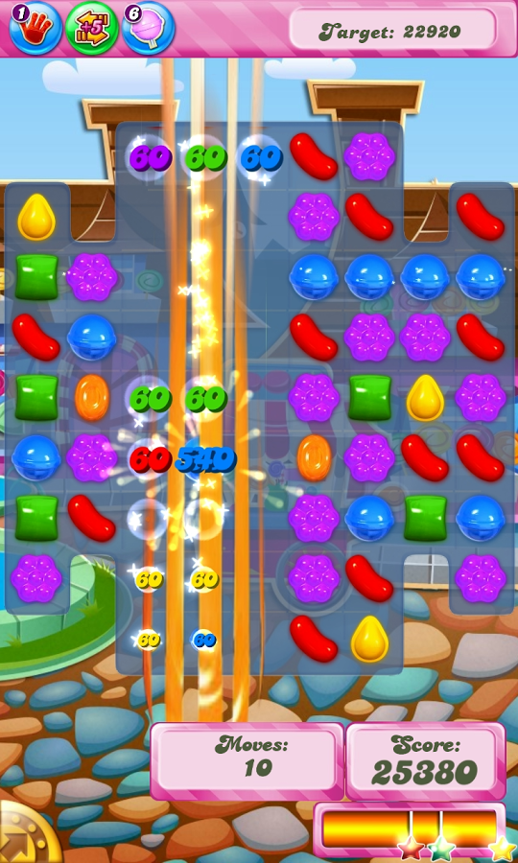
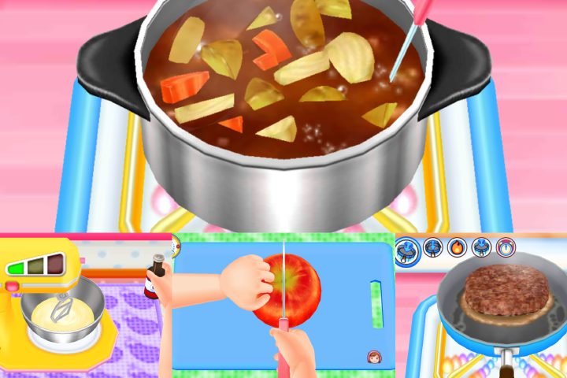
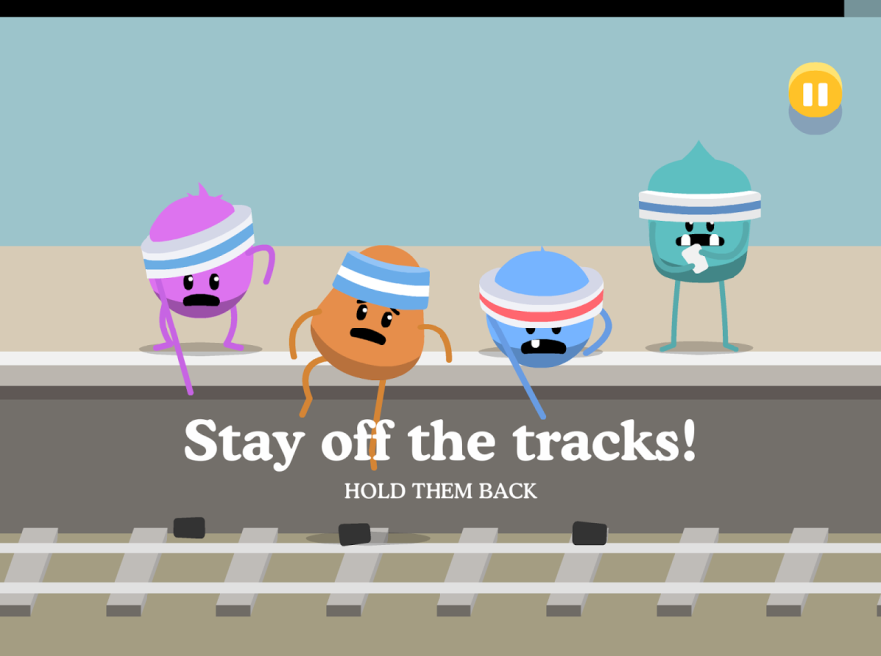
Casual Game Art styles Example
Notes:
These are Casual Games with their similar art styles
References
OfficeCreateCorp( 2nd February 2018) Cooking MAMA Let’s Cook!. Available at: https://play.google.com/store/apps/details?id=jp.co.ofcr.cm00 (Accessed: 04/02/2018)
Glu(9th January, 2018) Cooking Dash. Available at: https://play.google.com/store/apps/details?id=com.playfirst.cookingdashx(Accessed: 04/02/2018)
MetroTrains(23rd January, 2018) Dumb Ways to Die 2: The Games. Available at: https://play.google.com/store/apps/details?id=air.au.com.metro.DumbWaysToDie2Accessed: 04/02/2018)
King (17th January, 2018) Candy Crush Saga. Available at:https://play.google.com/store/apps/details?id=com.king.candycrushsaga (Accessed: 04/02/2018)

